Slide 1

Peer presentation
Ida & Elisa – Group 20
Picture is generated by ChatGPT

Slide 2
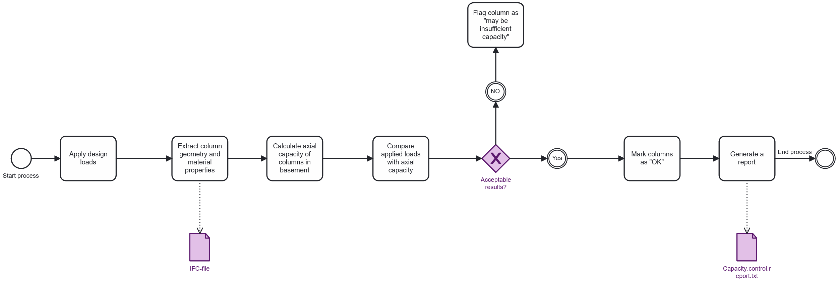
BPMN - tool
Notes:
The process starts by applying the design loads and extracting the columns geometry and material properties from the IFC model.
Based on this information, the tool calculates the axial capacity of the basement columns.
Then we compare the applied loads with the calculated capacity. If the results are not acceptable, the column is flagged as «may be insufficient». Is they’re acceptable, then it’s marked as OK.
Finally, the tool generates a capacity –control report summarizing all outcomes before the process ends.

Slide 3
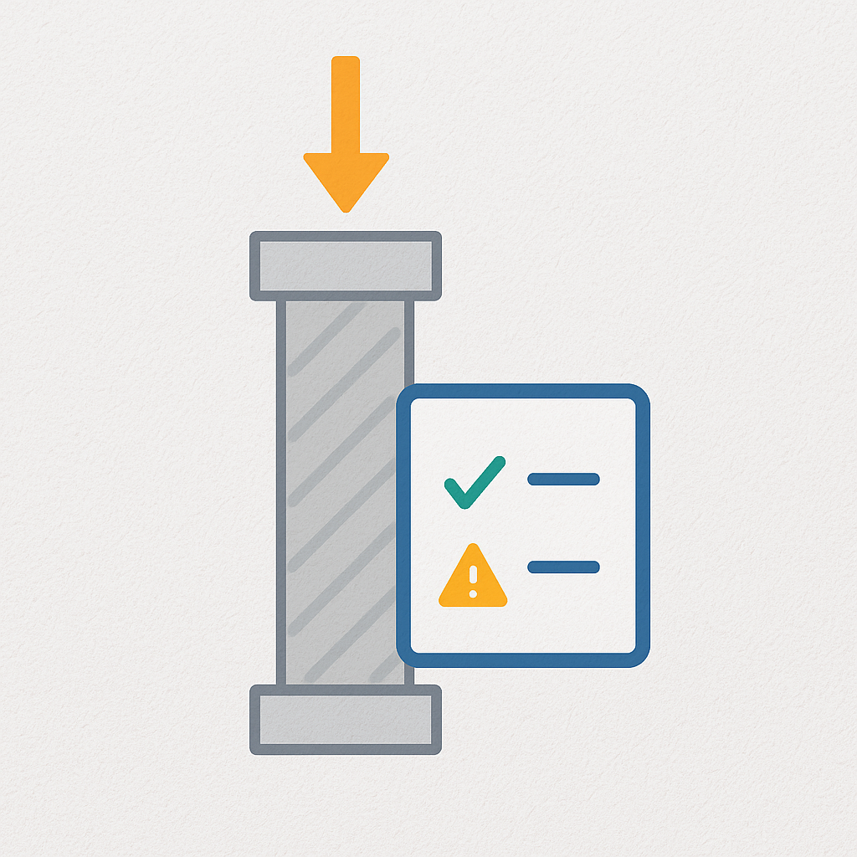




Aim of our tool
Evaluates axial load capacity of IFC Columns
Uses material, geometry, and Global ID
Checks loads from beams and slabs
Outputs a report: OK or Insufficient
Notes:
The aim of our tool is to evaluate the axial load capacity of the IFC columns, using key information such as material properties, geometry, and the Global ID from the IFC model.
It also checks the applied loads coming from beams and slabs connected to the columns.
Based on these inputs, the tool generates a simple report as an output, indicating wheter each column is OK or if the capacity is insufficient.
In short, it provides a fast and consistent way to verify the column capacity early in the design process.

Slide 4
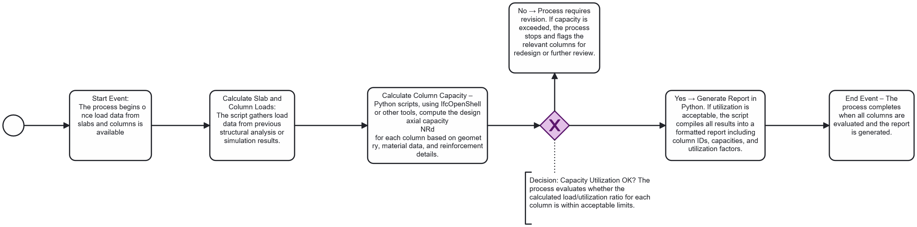
BPMN - workflow
Notes:
A more detailed workflow behind our tool.
During the process, we actually had to make one change. The original plan was to use load data from slabs and beams provided by another group, but during the process we switched to using the loads from the report from Advanced Building Design instead.
Next, we used the IFCOpenShell library to figure out how to extract all the information we needed to calculate the axial capacity for each column. We set up the script so that it can pull the relevant data depending on which storey you want to check. Since we focused on the basement, and all the columns there are concrete, we limited the material scope to concrete.
After that, we built the script that applies the loads to each column, computes the axial capacity, and then automatically generates a report with all the results directly into a folder. So the whole process, from reading the IFC-model to producing the final report, runs through the Python script.

Slide 5




Our tool
How to run the tool
1. Requirements:
🐍 Python
🧩 IfcOpenShell
2. Prepeare the IFC Model
- Save a structural model as an IFC file.
- Place it in the same folder as the script.
3. Run the script
Open the IFC file
- Apply the loads
- Run the code
4. Create a report with the results
“Capacity.control.report.txt” will be created automatically
Open report to see pass/fail status
Notes:
Now we’re going to explain how to run the tool
First, there are two requirements. You need Python installed, and you need the IFCOpenShell library to extract all the IFC data.
Step two is to prepare the IFC model. You simply save your structural model as an IFC file, and place the file in the same folder as the script. If not, you have to update the model path in the start of the script.
In step three, you run the script. Then the script will open the IFC file, apply the loads and run all the calculations automatically.
In the last step you have to open the text report that automatically is being created, to see the pass/fail status of the columns.

Slide 6
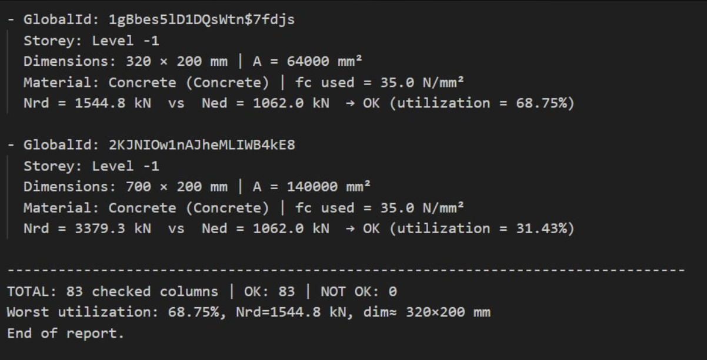
Output - "Capacity.control.report.txt"
Notes:
Here is an excerpt showing what the report looks like. It is sorted by the GlobalID of each column, making it easy to identify which column the calculations refer to. The report includes the storey where the column is located, its dimensions and material, the applied loads, the calculated capacity, the status check, and the utilization.
At the end, there is a summary showing how many columns were checked, how many passed, and how many did not. It also highlights the worst-case utilization and identifies which column it corresponds to.

